Slide 1
Sales Dataset Analysis-Advanced Excel Project
Surya V
12.12.2024
Data analytics & Data science
Oct 2024 (Regular)

Slide 2
Project overview
Overview:
To analyze sales data to identify trends, understand sales performance to make better decision for future sales.
Goal:
Analyze sales trends over time.
Identify high-performing products and sales channels.
Determine the impact of returns and discounts.
Create a dynamic dashboard with key metrics.

Slide 3
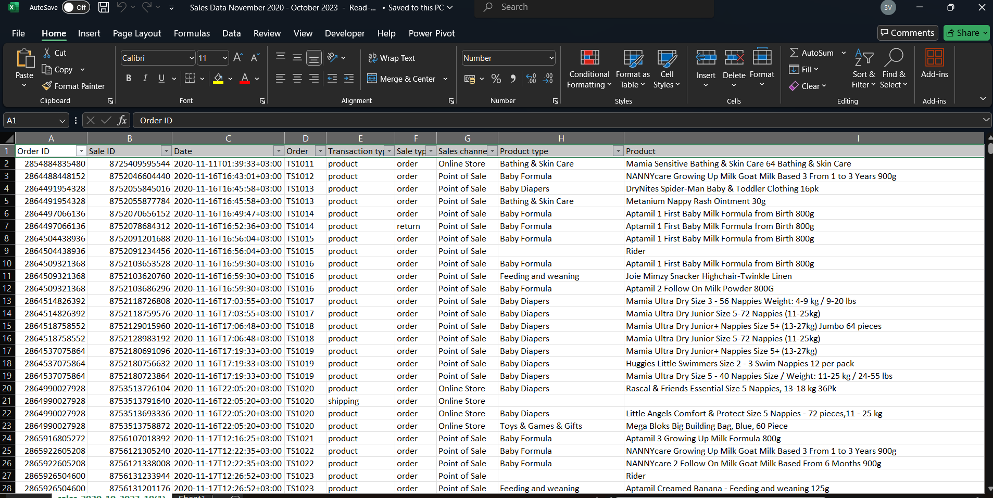
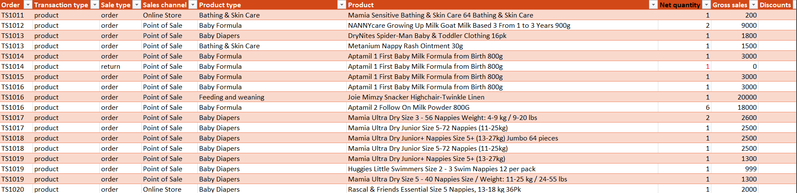
Data description
Data set overview
Dataset is about product sales both online and offline and sales through different channels
Data Cleaning
Cleaned the dataset using Power Query.
Removed Blank Rows, Duplicate Rows and Splitter Columns.

Slide 4
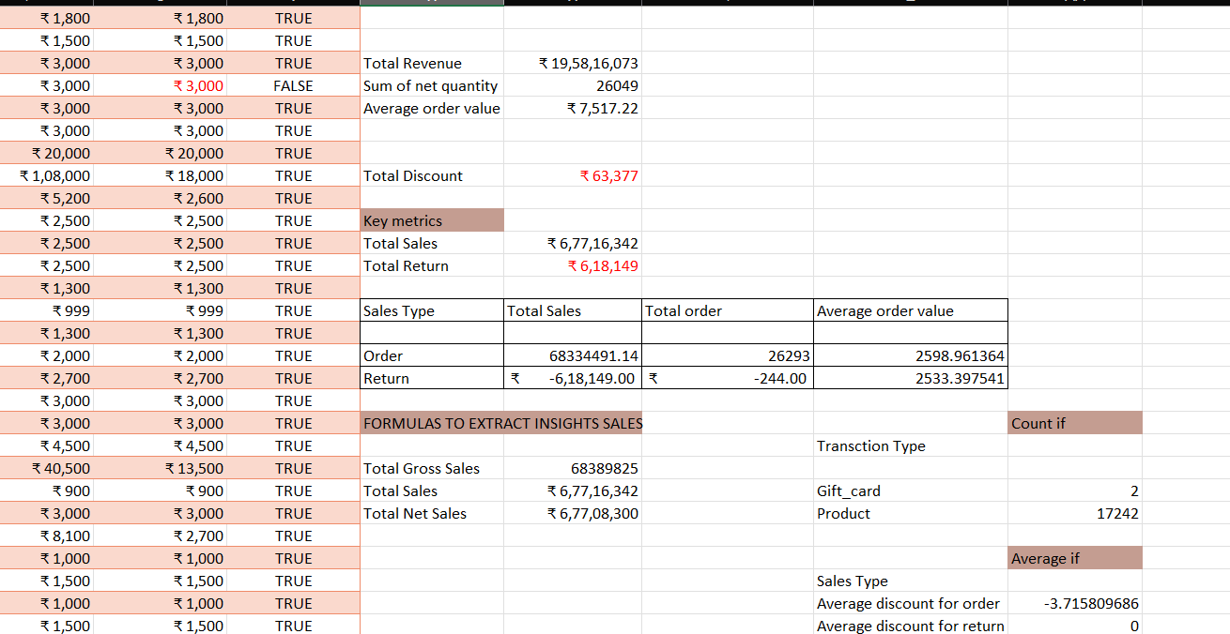
Key Metrics Calculation and Data Analysis
Total sales (Gross, Net, Adjusted)
Average sales per order
Discount rates, return rates
Sales by channel/product type

Slide 5
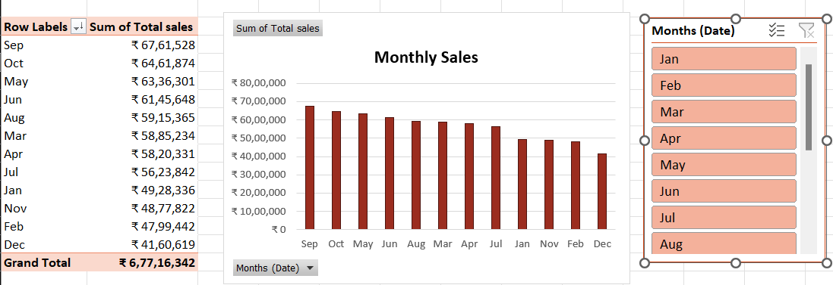
Pivot Tables and Charts
Used to find high performing products.
Used to find monthly sales trend.
Channel wise sales
No. of products returned or ordered

Slide 6
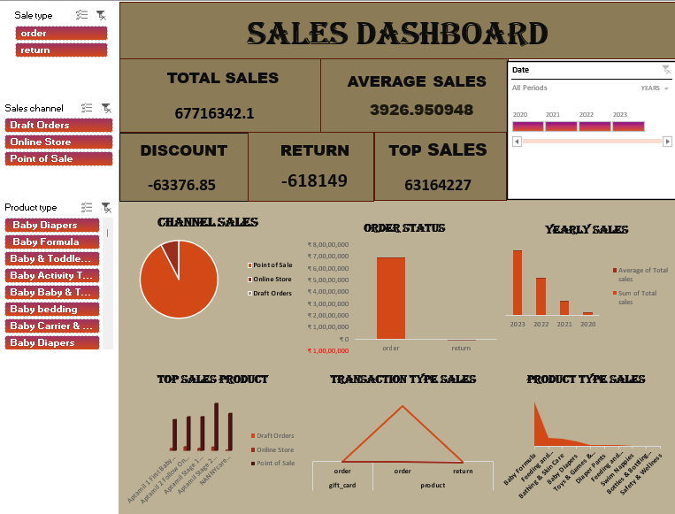
Dashboard

Slide 7
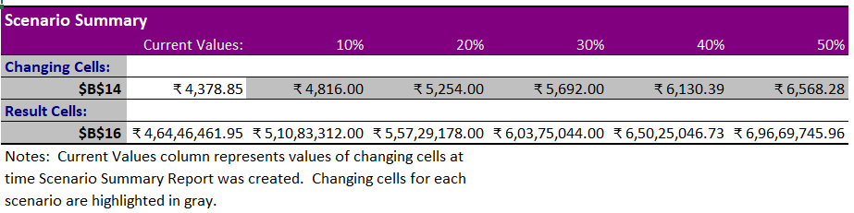
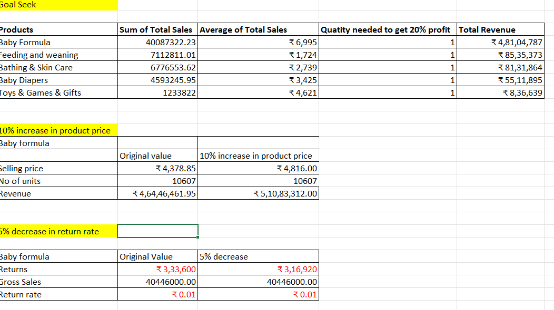
WHAT-IF ANALYSIS
What-if analysis is done using Goal seek and Scenario manager.
Target revenue 20%

Slide 8
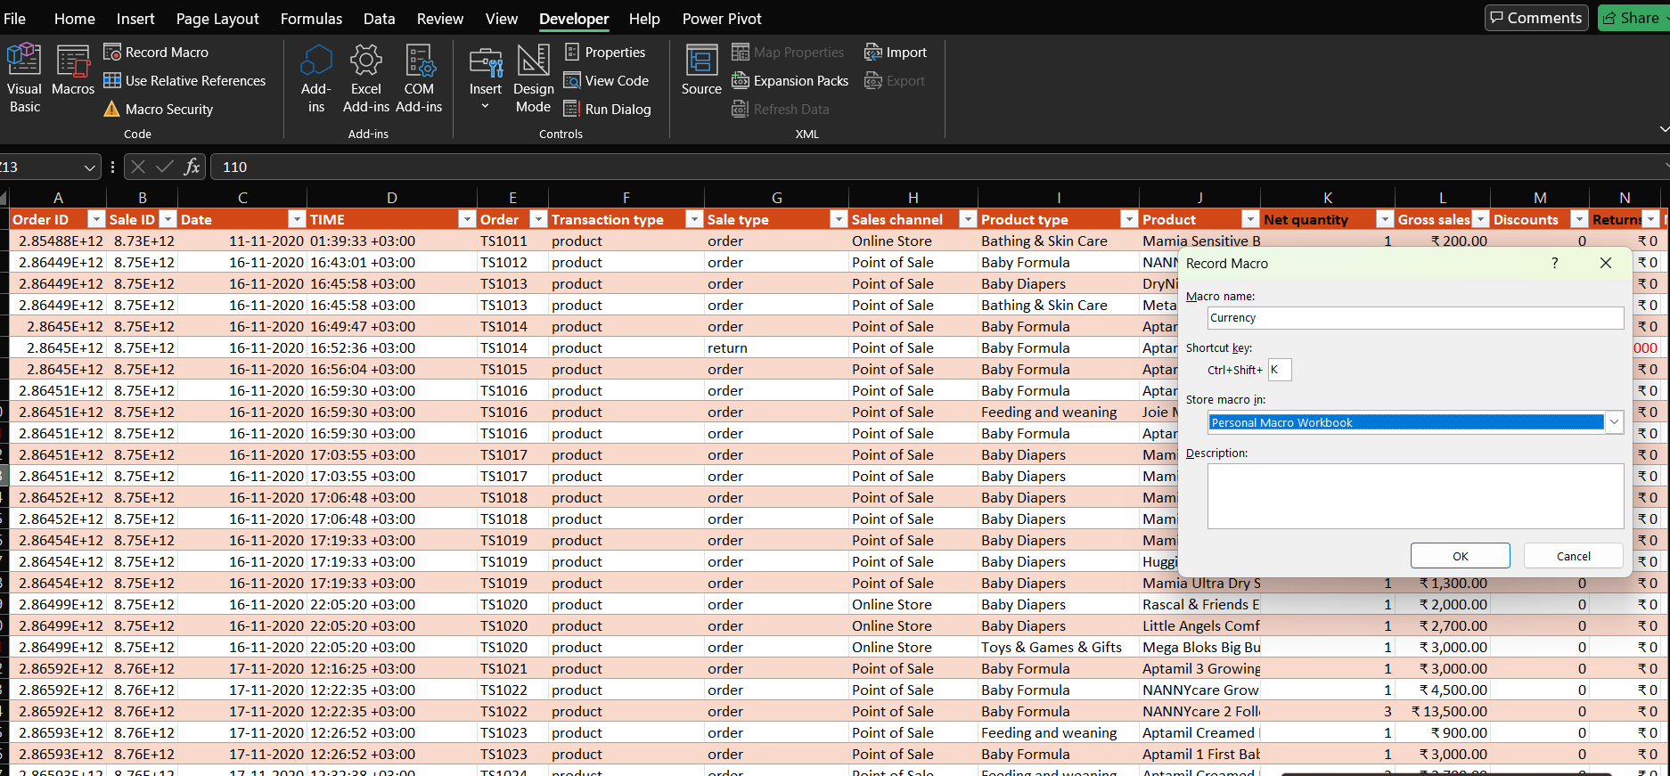
Macros and automation
Used Macros for changing the random formats to single format for all of them.

Slide 9
insights
Top selling Products are Baby Formula followed by feeding and weaning.
Seasonal Peak is in September
Gradually sales increased year by year.
Comparing Online and Offline sale, Sales increased in Offline.

Slide 10
conclusion
Our analysis shows that Baby Formula and feeding &weaning products have more sales in September. This trend demonstrates steady annual growth, highlighting opportunities for making growth in future by increasing more offers and discount in the sales.

